Slide 1






ACQF PILOT II PROJECT · DISSEMINATION OF DELIVERABLES
Greening Skills and Qualifications
in Africa — Users' Engagement
Sharing the project's three published deliverables — and how to put them to work.
PRESENTED BY
Samuel Sasu Adonteng
Deputy Chief Operating Officer (Technical) — AASU
James Kodjie
Chief Programmes Officer — AASU
July 2026
Notes:
Welcome. Today we are disseminating the three published deliverables of the GSQA-UE project, implemented by AASU with the European Training Foundation under ACQF Pilot II, co-funded by the European Union.

Slide 2




BACKGROUND
ALL-AFRICA STUDENTS UNION (AASU)
The All-Africa Students Union (AASU) is the umbrella organisation for all African students from the basic level to higher learning institutions and a very dominant force on the African Continent and beyond.
85+ Member Unions across the Continent
Over 300 million students in Africa and the diaspora
1972
FORMED
1990S
REINVENTED
ORGANISATION
2000
AWARDED BY UN
2022
GOLDEN JUBILEE

Slide 3

BACKGROUND
ALL-AFRICA STUDENTS UNION (AASU)
The Union achieves its core mandate through:
ADVOCACY
CAPACITY DEVELOPMENT
RESEARCH & KNOWLEDGE GENERATION
The Union campaigns actively in defense of students’ rights, and the passage of policies on the need for the democratisation of education across the Continent, with emphasis on access, equity and equality.
The Union facilitates education and training to build the capacities of students through conferences, seminars, training programs and educational materials to enhance the potential of graduates to access decent jobs, develop their leadership skills and significantly improve their skill sets.
The All-Africa Students Union (AASU) advances its core mandate through research and knowledge generation by producing evidence-based insights that inform policy, advocacy, and programme design across the continent. Through strategic studies, student-led research initiatives, and partnerships with academic and policy institutions, AASU ensures that the voices and experiences of African students are systematically documented and integrated into continental and global education discourse.
NETWORKING
PARTNERSHIPS
The Union creates the platform and environment for networking amongst members aimed at building closer relations for healthy partnerships.
The Union constantly seeks out collaborative partnerships with like-minded organisations to work together to advance progressive agendas.

Slide 4

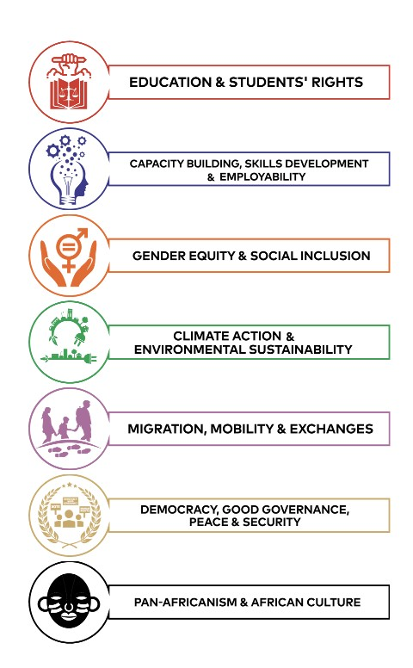
ABOUT AASU
The Seven (7) Strategic Priorities of the Union are:
STRATEGIC PRIORITIES OF THE ALL-AFRICA STUDENTS UNION
AASU’s Strategic Priorities are fully aligned to the UN and AU’s development priorities as articulated in the Sustainable Development Goals (SDGs) and Agenda 2063 respectively. In addition, these priorities complement the global efforts to build a relevant contemporary human capital, capable of fitting into the global citizen ecosystem.

Slide 5


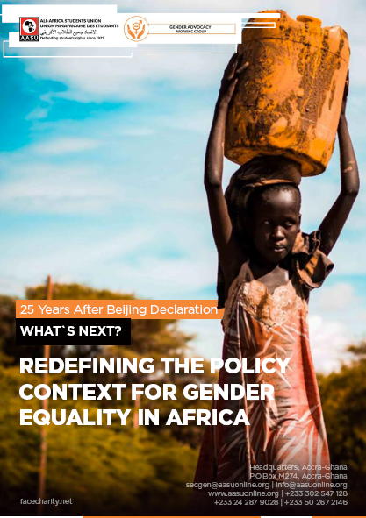



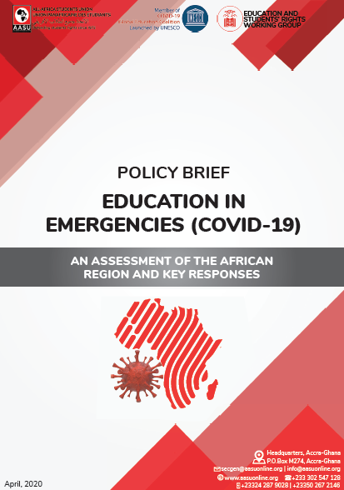



SOME AASU PUBLICATIONS

Slide 6



THE PROJECT
GSQA-UE: Greening Skills & Qualifications in Africa — Users' Engagement
Africa is highly vulnerable to climate change and economically dependent on climate-sensitive sectors — a skilled workforce for a sustainable green economy is urgent. Under ACQF Pilot II, the All-Africa Students Union, working with the European Training Foundation, undertook GSQA-UE to lay the foundation for aligning green skills with education and qualifications frameworks across the continent.
THREE DELIVERABLES
01
Concept Document
A working definition of green skills, adapted to the African context.
02
Case Book of Good Practices
ACQF PILOT II · AASU × ETF · CO-FUNDED BY THE EUROPEAN UNION
Documented practices on greening skills and qualifications across Africa.
The project is complete — all three deliverables are published. Today is about putting them in your hands.
03
Stakeholder Toolkit
Practical guidance for embedding green skills in education & training systems.
GSQA-UE · Greening Skills and Qualifications in Africa — Users' Engagement
04

Slide 7






THE PROJECT
How We Engaged Users Across the Continent
KEY METRICS
Survey Distribution
2,125+
60+
Students in universities, colleges & TVET centres · industry experts & employers · National Qualifications Authorities · TVET, HEIs & CSOs · religious & traditional leaders.
hours of research, review,
meetings & coordination
scholarly & policy
articles reviewed
One-on-One Interviews
14
150+
Conducted with selected stakeholders across the same groups, for deeper insight into needs, gaps and practice.
interviews across
10+ African countries
survey
respondents
GSQA-UE · Greening Skills and Qualifications in Africa — Users' Engagement
05

Slide 8
AUDIENCE PULSE · LET'S HEAR FROM YOU
Q1
In one word — what comes to mind when you hear “green skills”?
Shout it out, or drop it in the chat. We will come back to your words in a moment.
GSQA-UE · DISSEMINATION SESSION

Slide 9


DELIVERABLE 01 · CONCEPT DOCUMENT
What Are Green Skills? An African Definition
“A set of technical, transversal, socio-cultural and adaptive competences that enable individuals and communities to participate in, contribute to, and benefit from Africa's transition towards environmentally sustainable, climate-resilient and resource-efficient economies. These competences draw equally from formal learning, informal and indigenous knowledge systems, and practical experiences across both formal and informal labour markets.”
— Greening Skills and Qualifications in Africa: Users' Engagement, 2025
The Concept Document — the project's analytical foundation
GSQA-UE · Greening Skills and Qualifications in Africa — Users' Engagement
07

Slide 10




DELIVERABLE 01 · CONCEPT DOCUMENT
Why Green Skills Matter
Climate Change Response
Employment & Future Jobs
They enable people and organisations to adapt and mitigate — sustainable practices, renewable energy, efficient resource use, lower emissions.
As economies shift to green growth, demand is rising fast for skills in renewables, waste management, sustainable agriculture and the circular economy.
Resilience
Social Justice & Inclusion
They help societies withstand environmental shocks — floods, droughts, pollution — through adaptive housing, food systems and infrastructure.
They ensure vulnerable groups are not left behind, but actively benefit from the opportunities of the transition.
GSQA-UE · Greening Skills and Qualifications in Africa — Users' Engagement
08

Slide 11





DELIVERABLE 01 · CONCEPT DOCUMENT
Top 5 Green Sectors in Africa
1
Renewable Energy
Solar, wind, hydro and clean-energy value chains powering the transition.
2
Climate-Smart Agriculture
Sustainable production, agro-ecology and resilient food systems.
3
Waste & Circular Economy
Recycling, valorisation and circular business models.
4
Sustainable Construction
Green building, efficient materials and climate-proof infrastructure.
5
Green Transport
Clean mobility and low-emission logistics.
Source: Greening Skills and Qualifications in Africa — Users' Engagement, 2025
GSQA-UE · Greening Skills and Qualifications in Africa — Users' Engagement
09

Slide 12
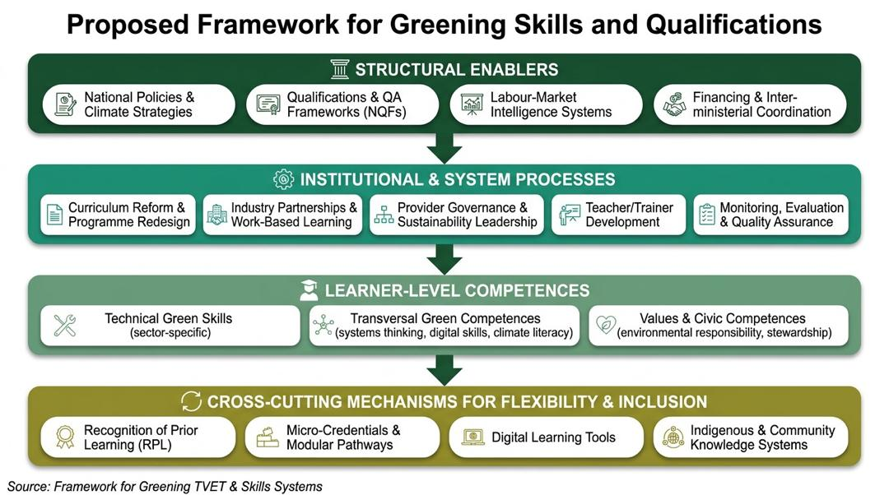

Slide 13
AUDIENCE PULSE · LET'S HEAR FROM YOU
Q2
Which of these five sectors (Renewable Energy, Climate-Smart Agriculture, Circular Economy, Sustainable Construction, Green Transport) holds the biggest opportunity for young people in your country — and why?
Quick show of hands per sector — then two volunteers tell us why.
GSQA-UE · DISSEMINATION SESSION

Slide 14




DELIVERABLE 02 · CASE BOOK
A Continental Call for Good Practices
FOUR FOCUS AREAS
PROJECT SCOPE — 13 ACQF PRIORITY COUNTRIES
Education & Training
Embedding green skills into curricula
Angola · Botswana · Cabo Verde · Cameroon · DR Congo · Ghana · Mozambique · Senegal · Sierra Leone · The Gambia · Togo · Uganda · Zimbabwe
Industry & Workforce
Closing skill gaps for the green economy
Policy & Advocacy
Supporting policy alignment for sustainability
SEVEN-POINT SELECTION CRITERIA
Strategic relevance · Innovation · Demonstrated impact · Scalability · Stakeholder engagement · Policy alignment · Quality of evidence
Indigenous Knowledge
Leveraging local practice for climate action
GSQA-UE · Greening Skills and Qualifications in Africa — Users' Engagement
11

Slide 15
DELIVERABLE 02 · CASE BOOK
From 17 Submissions to 6 Featured Practices
17
5
6
→
→
submissions received after the
2025 ACQF–AASU continental call
African subregions represented
among submitting organisations
best practices selected for in-depth
documentation & cross-case analysis
SUBMISSIONS CAME FROM
Nigeria · Sierra Leone · Mozambique · Zambia · Tunisia · Guinea-Bissau · Kenya · The Gambia · Cameroon · Mauritania · Egypt · Niger
The six featured practices are documented in full in the Case Book — three of them follow.
The Case Book
GSQA-UE · Greening Skills and Qualifications in Africa — Users' Engagement
12

Slide 16

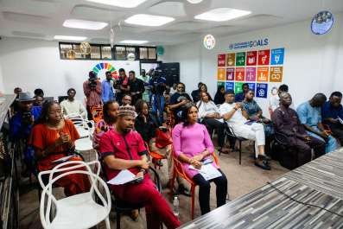
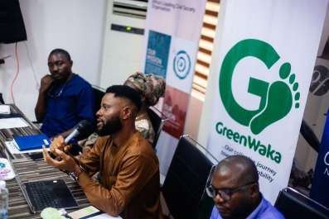
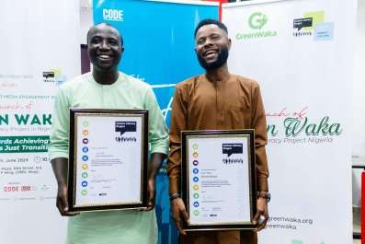
CASE BOOK · FEATURED PRACTICE 1 OF 3
Carbon Literacy Project — Scalable Climate Education
NIGERIA
CLIMATE EDUCATION
Implemented by the West Africa Green Economic Development Institute, building on the principle that “you can't act on what you don't know”.
Certification requires two measurable climate actions — so learning always converts into impact.
100,000+ people certified Carbon Literate and 4,000+ facilitators trained through a train-the-trainer model.
Recognised by the UN among the top 100 transformative initiatives; piloted and localised in Nigeria, Kenya and South Africa.
Flexible, accredited, modular curriculum — adaptable to African contexts and supportive of ACQF goals.
Carbon literacy training sessions and certificate presentations.
GSQA-UE · Greening Skills and Qualifications in Africa — Users' Engagement
13

Slide 17
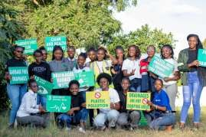
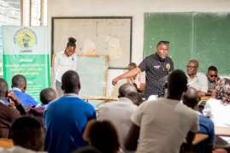
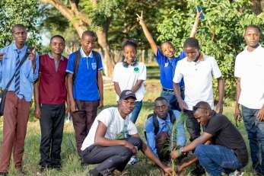
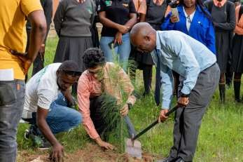
CASE BOOK · FEATURED PRACTICE 2 OF 3
TWESEP — Tourism, Wildlife & Environmental Education
ZAMBIA
YOUTH EMPOWERMENT
Implemented by the Know Your Wildlife and the Environment Zambia (KWEZ) Initiative; launched January 2023 across 10 schools.
The first Zambian initiative integrating tourism into environmental education — aligned with ACQF lifelong-learning goals.
150+ students trained as climate-education volunteers through a student-to-pupils model.
Eco-club mentorship, tree planting, recycling and eco-art competitions embed practical green skills in communities.
Delivered with ActionAid, the University of Zambia, Copperbelt University, government agencies and NGOs.
Training on climate action, and students undertaking tree planting.
GSQA-UE · Greening Skills and Qualifications in Africa — Users' Engagement
14

Slide 18
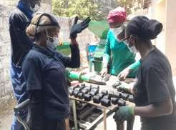
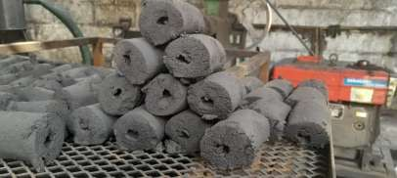
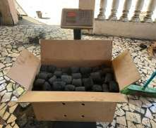
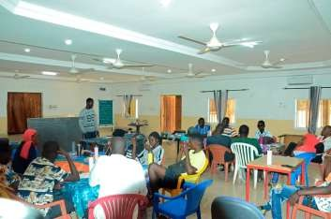
CASE BOOK · FEATURED PRACTICE 3 OF 3
GreenCoal — Green Skills & the Circular Economy
THE GAMBIA
CIRCULAR ECONOMY
Implemented by Green-Up Gambia, where 40% of urban households depend on charcoal and only 3% of organic municipal waste is recycled.
Trains youth and women in biomass processing, biochar and briquette production — clean energy from waste.
Community-based Recognition of Prior Learning and micro-credentials, delivered with TVET partners.
An enterprise incubator provides starter kits, mentorship and market linkages for climate-smart micro-enterprises.
Advocacy in municipal and national climate and waste forums to influence green-jobs policy.
Biochar briquette production and community engagement on the charcoal-to-briquette transition.
GSQA-UE · Greening Skills and Qualifications in Africa — Users' Engagement
15

Slide 19
AUDIENCE PULSE · LET'S HEAR FROM YOU
Q3
Which green practice in your community deserves a place in the next Case Book?
Sixty seconds — share one example with the person next to you. We will take three from the floor.
GSQA-UE · DISSEMINATION SESSION

Slide 20
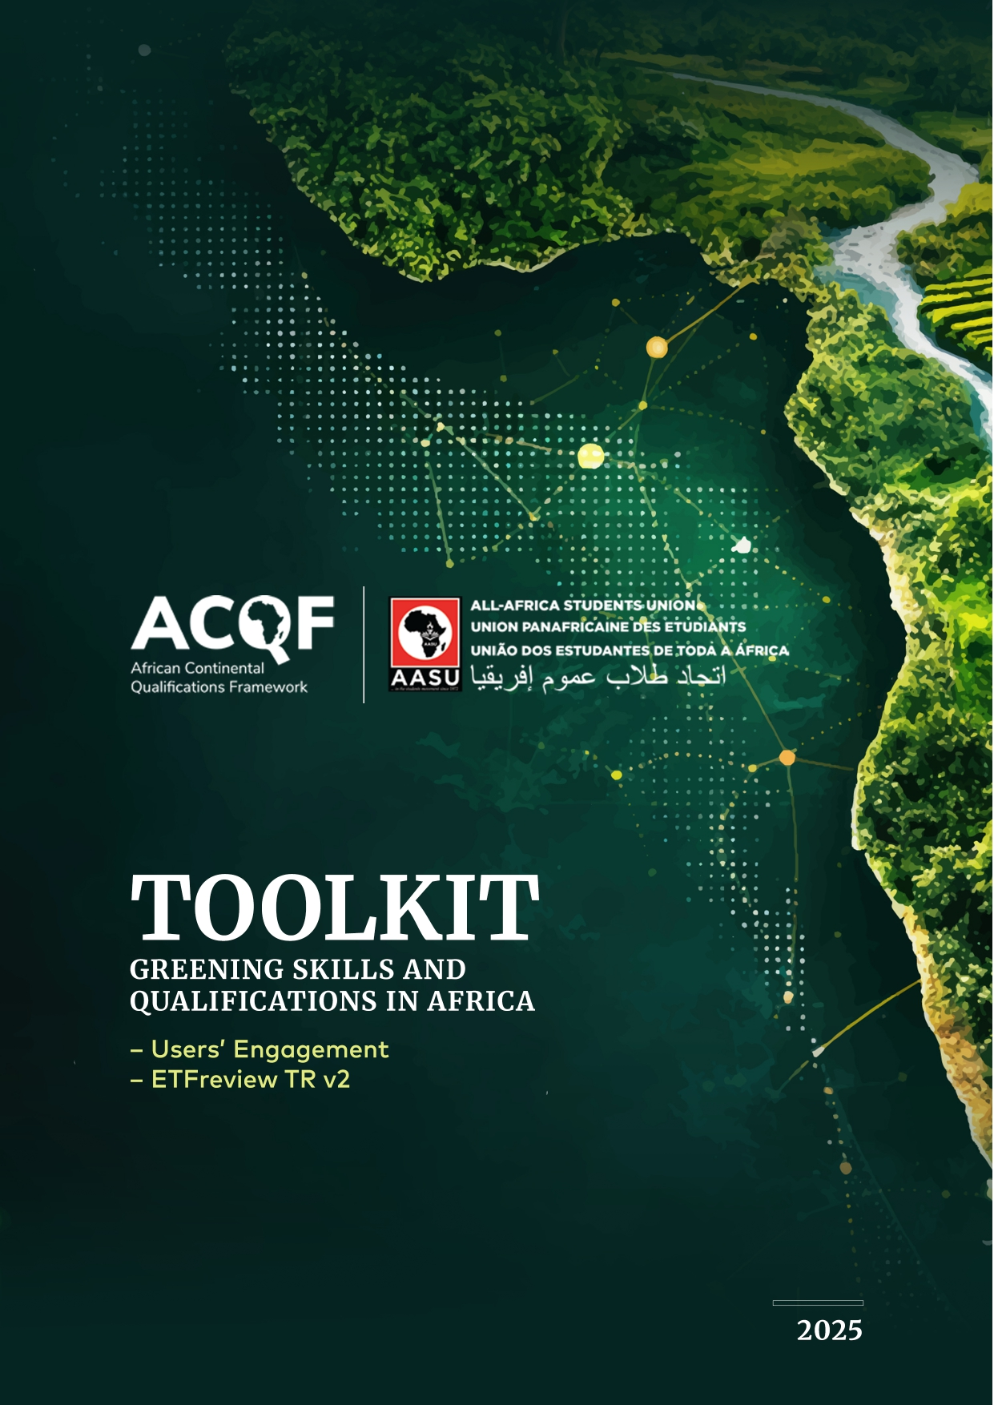
DELIVERABLE 03 · STAKEHOLDER TOOLKIT
A Practical Toolkit for Every Stakeholder
01
Equip Stakeholders
GUIDED NAVIGATION
Knowledge, tools and strategies to integrate green skills into education, training, policy and community practice.
Enter by role — educator, policymaker, TVET provider, student or community leader — and follow tailored implementation pathways.
02
Support Climate Action
Enhances social equity and contributes to Africa's sustainable and just transition.
03
Step-by-Step Guidance
Participatory processes for defining green competences and revising qualifications and curricula.
WHO SHOULD USE IT
Schools & training institutions
Students & youth organisations
04
Ready-to-Use Formats
Workshop designs and communication ideas, adaptable to different contexts — use only the modules you need.
Policymakers & regulators
National Qualifications Authorities
Religious & traditional leaders
Community & civil society
GSQA-UE · Greening Skills and Qualifications in Africa — Users' Engagement
17

Slide 21


FROM FINDINGS TO ACTION
Recommendations — Who Must Do What (1 of 2)
National Governments & Policymakers
National Qualifications Authorities
Universities, Polytechnics & TVET Centres
Make green skills a national priority: align education, labour, climate and industrial policies, strengthen labour-market intelligence, update NQFs and finance system-wide training reform.
Revise occupational standards and qualifications to embed green competences, strengthen RPL and quality assurance, and align national systems with ACQF green-competency frameworks.
Mainstream sustainability across curricula, expand practical green training infrastructure, invest in educator capacity and deepen industry-linked, work-based learning.
GSQA-UE · Greening Skills and Qualifications in Africa — Users' Engagement
18

Slide 22

FROM FINDINGS TO ACTION
Recommendations — Who Must Do What (2 of 2)
Industry & the Private Sector
Youth, Students & Community Actors
ACQF II Implementation
Co-design green curricula, open practical training opportunities, align workforce strategies with climate priorities and support sector skills councils for green transitions.
Ensure youth inclusion in decision-making, expand green career pathways and flexible learning, back youth-led climate initiatives and recognise community knowledge through RPL.
Strengthen continental coordination through harmonised frameworks, expanded RPL, targeted technical assistance, peer learning and learner-mobility mechanisms.
GSQA-UE · Greening Skills and Qualifications in Africa — Users' Engagement
19

Slide 23
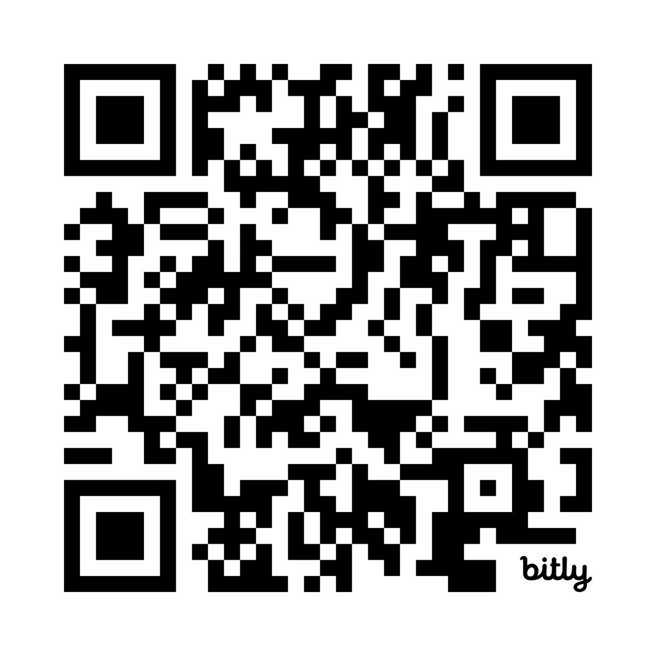
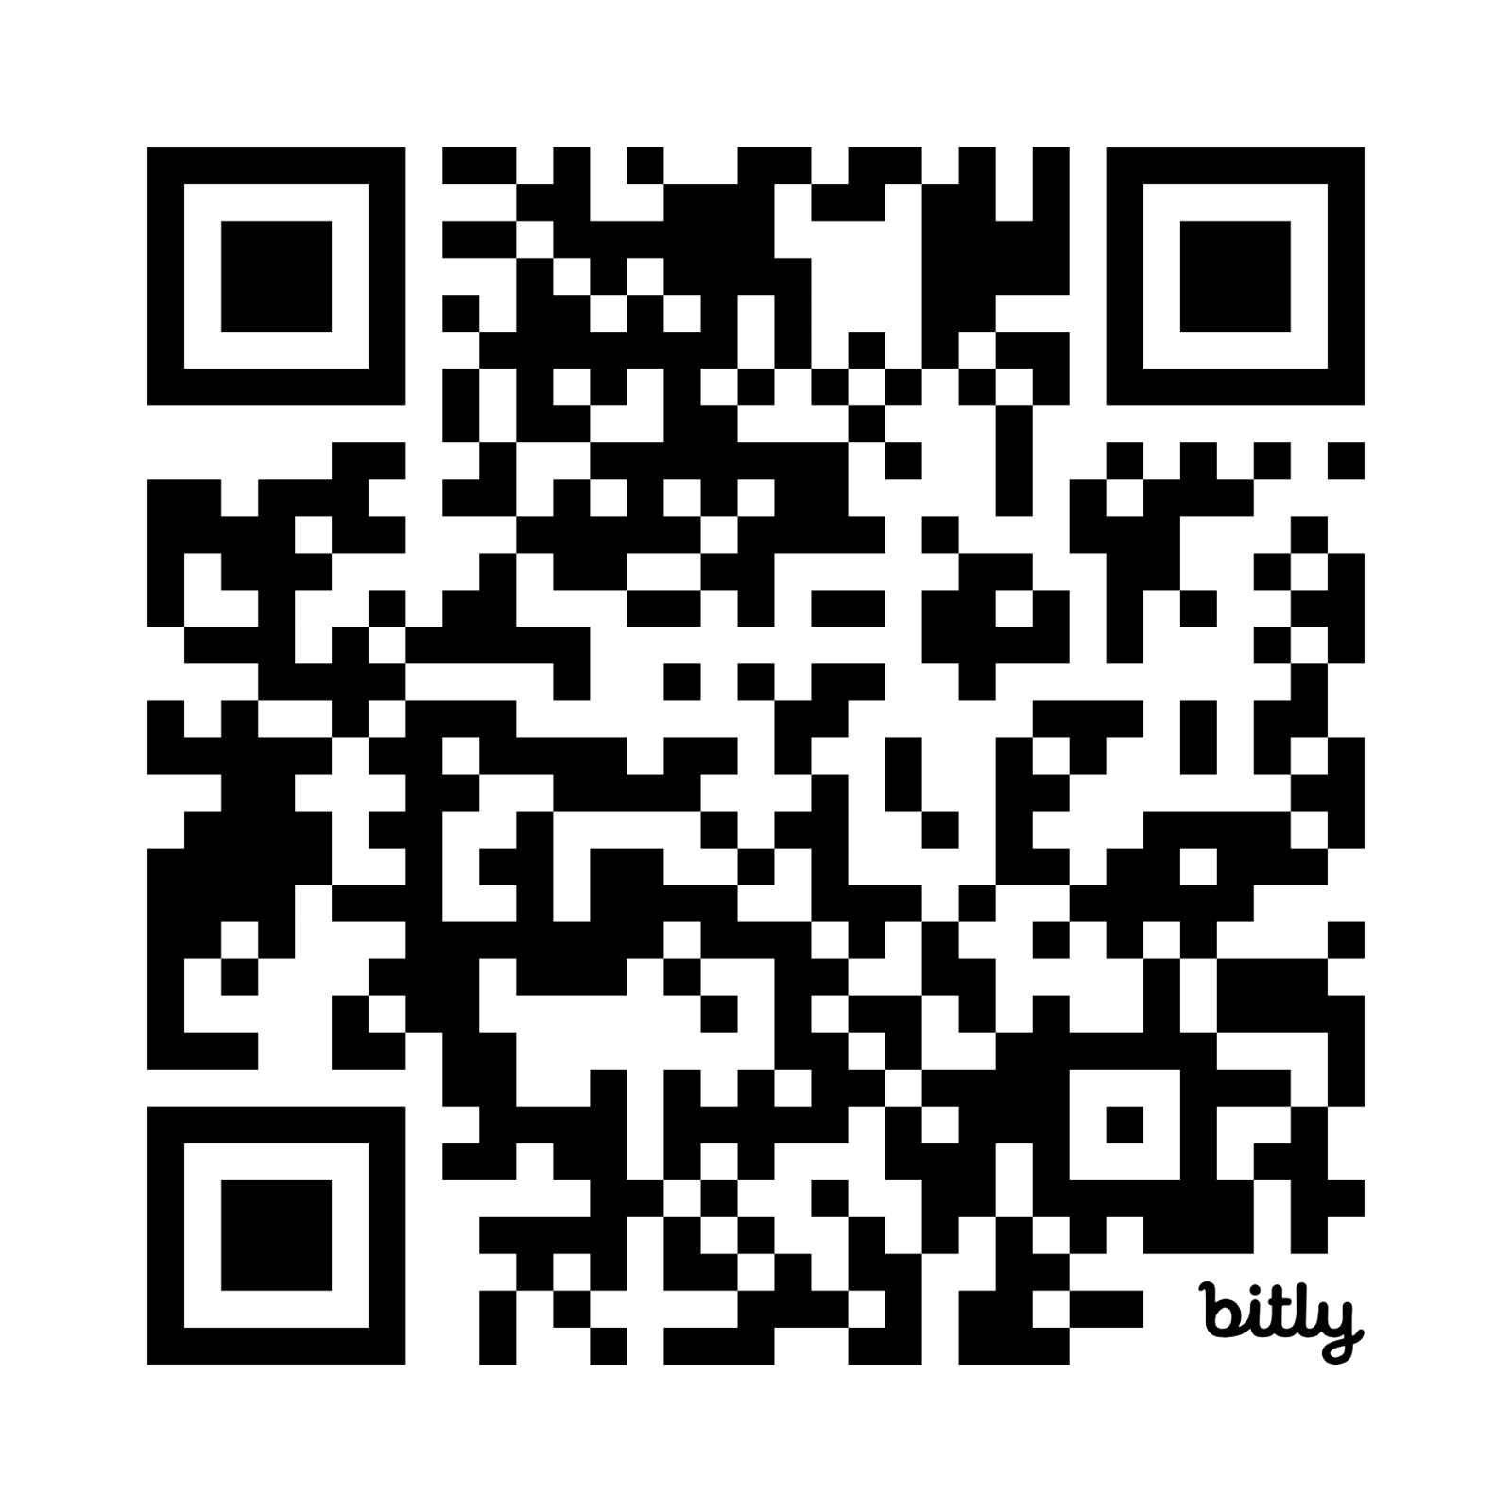
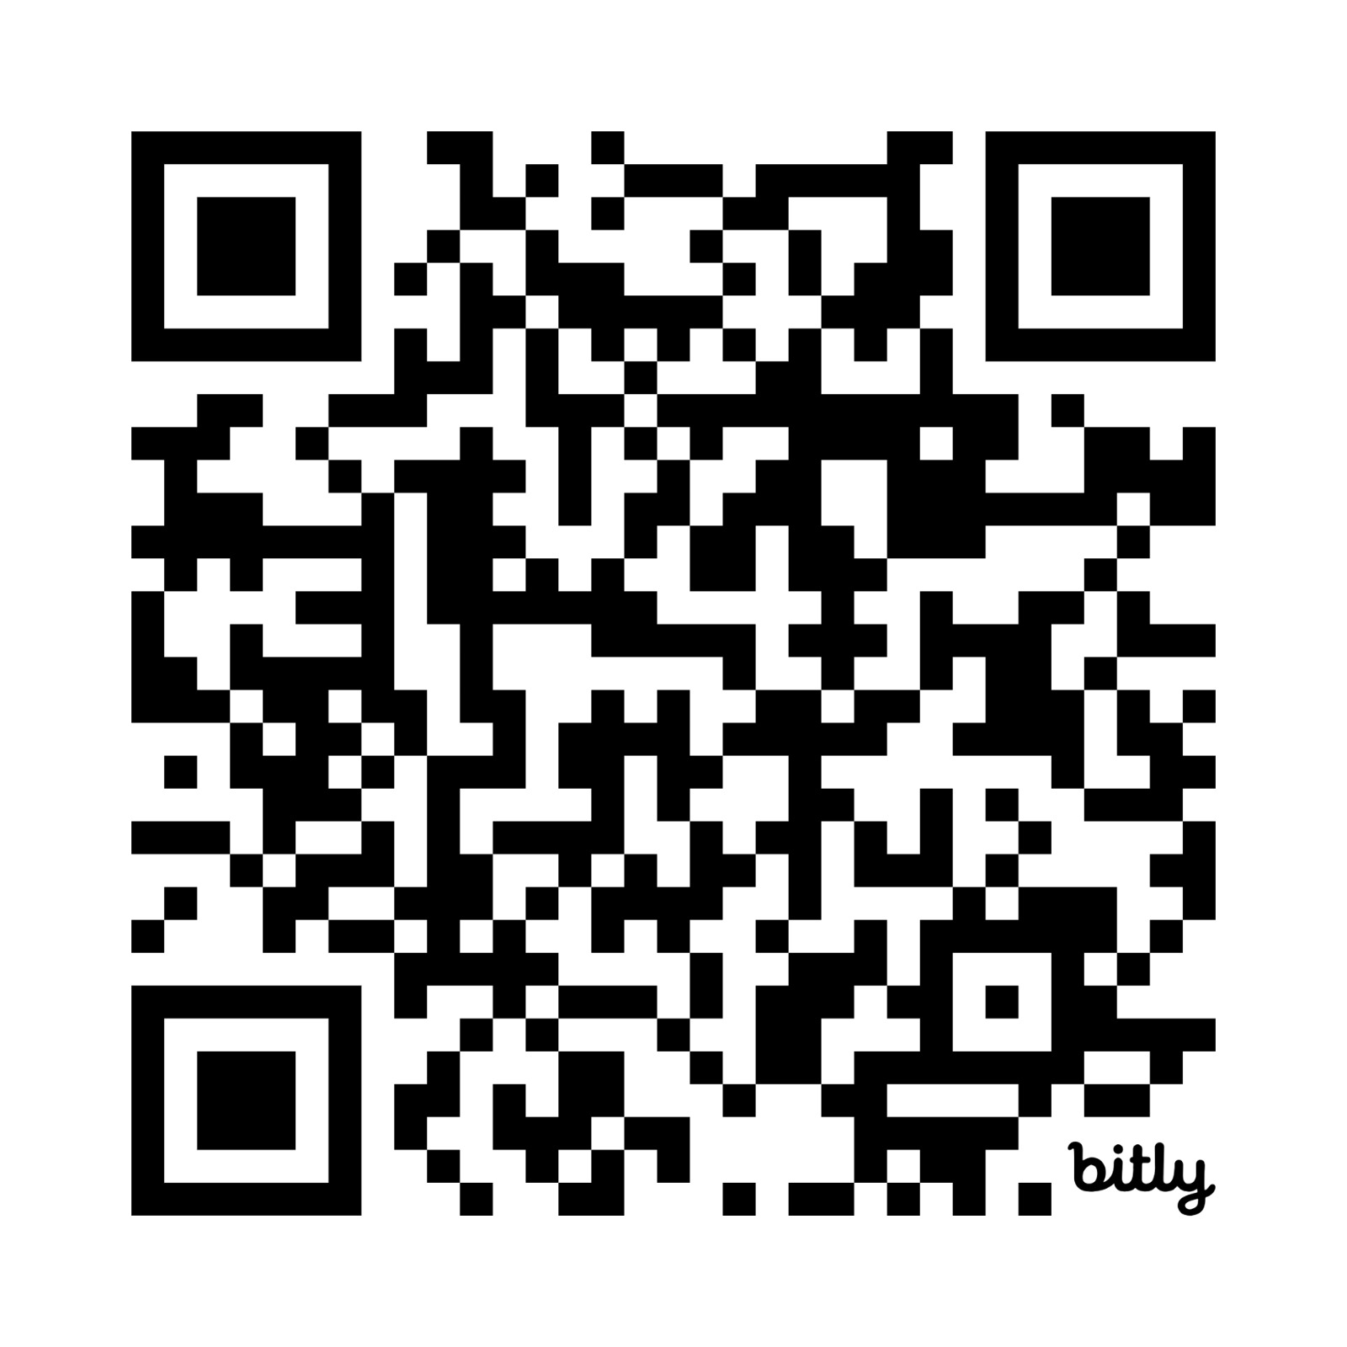
DISSEMINATION
Take Them With You — Scan & Download
SCAN ME
SCAN ME
SCAN ME
Concept Document
Case Book of Good Practices
Stakeholder Toolkit
Definition & analytical framework
Six featured practices from across Africa
Embedding green skills in systems
All three deliverables live at acqf.africa → Resources → Research → Green Skills
GSQA-UE · Greening Skills and Qualifications in Africa — Users' Engagement
20

Slide 24
AUDIENCE PULSE · LET'S HEAR FROM YOU
Q4
What is one step your institution can take in the next 90 days to put these tools to work?
One commitment per table — write it down. We will collect them before we close.
GSQA-UE · DISSEMINATION SESSION

Slide 25
THANK YOU
Akpe · Asante Sana · Medaase · Shukran · Obrigado · Merci · Zikomo
Let's keep the conversation going — and the deliverables moving.
www.aasuonline.org info@aasuonline.org @aasu_1972
Implemented by the All-Africa Students Union with the European Training Foundation
under ACQF Pilot II · Co-funded by the European Union
Notes:
Close by thanking ETF, the EU and ACQF partners; invite participants to scan the QR codes before leaving and to submit their 90-day commitments.

